Slide 1

Smart Kitchen
Matriculation Number: 30555400
Name: Bachu Dhyaneswar

Slide 2
Introduction
My project simulates a smart kitchen that connects to an MQTT broker.
The system:
monitors temperature
detects gas leaks
senses motion
and controls appliances like lights and fans.
It uses Counterfit to simulate sensors and devices in Python

Slide 3
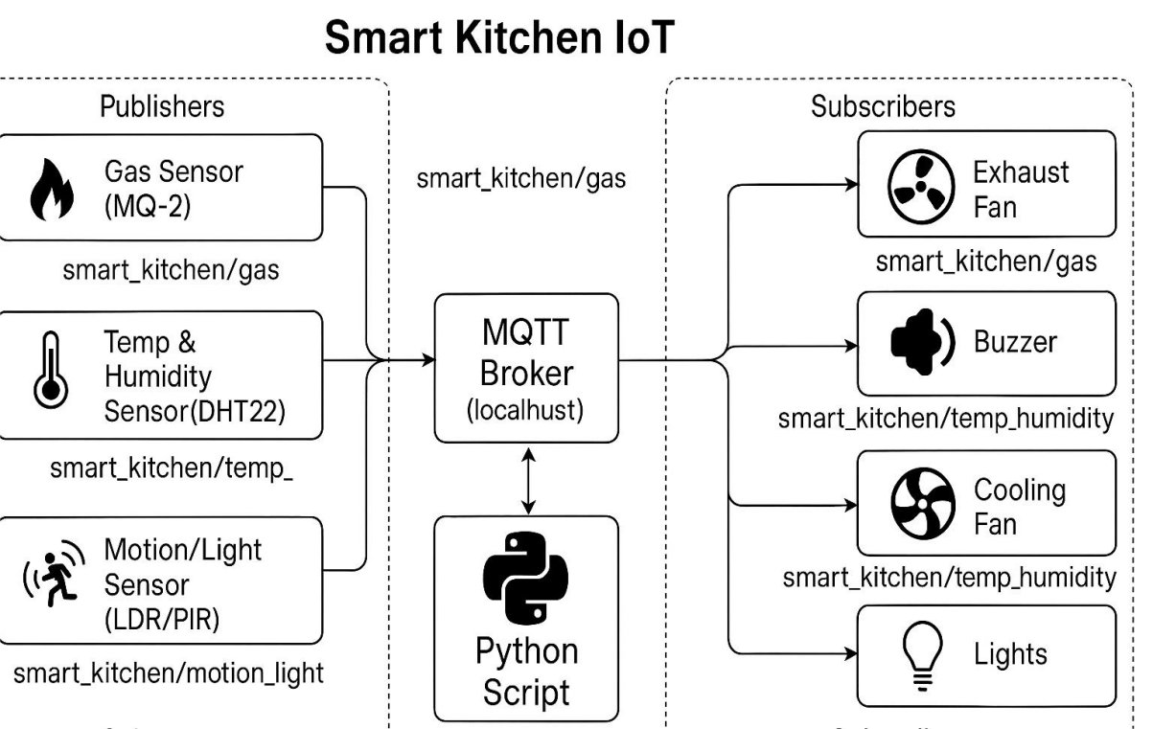
Architecture

Slide 4
Gas Leak Detection
Detects harmful gases like LPG using the MQ-2 sensor.
Continuously reads gas concentration.
If it exceeds a safe level:
sends an MQTT alert,
turns on the exhaust fan,
and optionally triggers a buzzer.

Slide 5
Temperature Monitoring
Uses a DHT22 sensor.
Monitors temperature and humidity near the stove.
Publishes data to MQTT.
If temperature is too high:
sends alerts,
and activates a cooling fan or buzzer,
preventing fire hazards.

Slide 6
Smart Light and Fan control
Uses a motion sensor (like LDR or PIR).
Detects if someone is in the kitchen.
Automatically turns lights on and off.
Publishes usage data to MQTT.

Slide 7
Central Python Controller
Acts as the brain of the system.
Reads data from Counterfit sensors.
Decides what actions to take.
Sends commands to devices like fans, lights, or buzzers.
Publishes all status updates to MQTT topics, for example:
smart_kitchen/status

Slide 8
MQTT Broker
I use Mosquitto as the MQTT broker.
It:
collects data from all devices,
sends data to subscribers,
and allows remote monitoring of the kitchen in the future.

Slide 9
Python Libraries
time — to handle timing and delays
json — for formatting messages
CounterFitConnection — to connect to Counterfit
GroveGasSensor — for reading gas sensor values
GroveDhtSensor — for temperature and humidity
GroveLightSensor — for light detection
GroveRelay — to control actuators
paho-mqtt — for MQTT communication

Slide 10
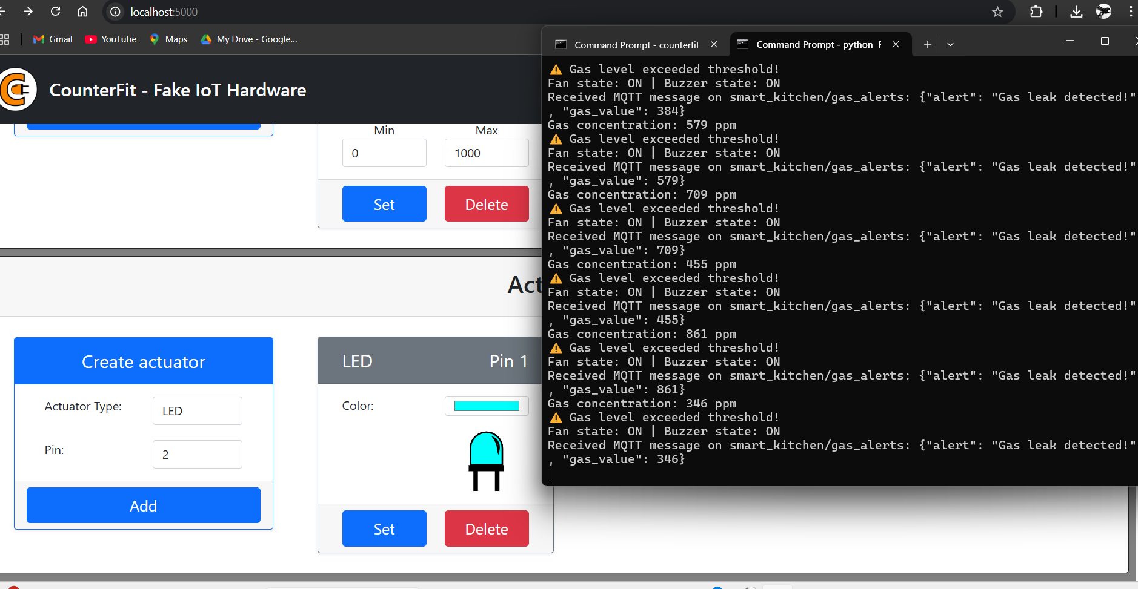
Output

Slide 11
Conclusion
This project shows how IoT can make a kitchen safer and smarter.
It uses Counterfit for simulation.
It uses MQTT for device communication.
And it’s all controlled with Python.

Slide 12
THE END

